Slide 1
My Business model
By: Maheswar Godithi

Slide 2
Introduction
Simply describing, my business plan is an aggregate business model.
We simply tie up with hostels and provide time period based rooms for our customers to book their hostel rooms. Location based across number of choices on a tap of a button. We as an organisation gets contracted with all 0*-2* rating hostels and then co-brand them to look better with good bit of customers. It is as simple as oyo but as tough as Oravel stays. But I with all your support hope for this journey.

Slide 3
Services we provide:
1. Commission based service.
2. Partnership based service.

Slide 4
Other income models:
Advertising for others
Sponsors and partnerships
Hostel reservation fee

Slide 5
Focus groups:
Hygiene.
Safety and security.
Food (Standardised menu).
Affordable and comparable prices.
Transport facility.

Slide 6
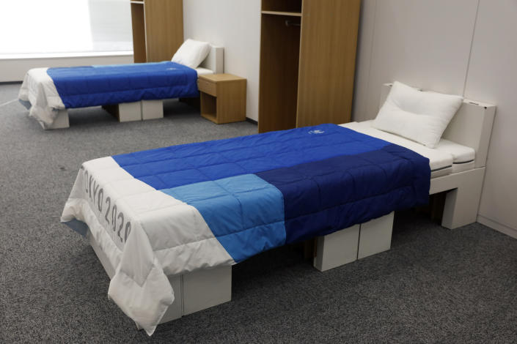
Innovative ideas:
Recyclable beds in place of regular beds.

Slide 7
Conclusion:
Hereby , I thank you all for your precious time and making this session very interactive.

Slide 8


